Slide 1
Extending Opus
Modules, ant scripts, extension points and institution specific logic

Slide 2
Overview
What do we do in order to improve or extend Opus?
Changes to Opus range from small local adaptations to full blown modules
Problem: How to allow both local changes at universities and changes at the central repository?

Slide 3
Update compatibility
Keep central repository compatible with local Opus instantiation
Problem when merging local and remote changes
Central
repository
Implementing
university
Opus Version A
ready
Installation of Version A
Time
Local adaptations to Version A
Other changes
→ Version B
Update to Version B

Slide 4
Types of modification to Opus
Three different scenarios:
Bug fix or general improvement
Independent functionality in module
(e.g. fee module)
Overriding particular (default) behavior
(e.g. student number generator)
Important: Do not loose update compatibility with any type of source code modification
Special case: translations come with their own framework
e.g. messages_en_ZM.properties

Slide 5
(1) Bug fix or general improvement
Bug fix and improvements that are of general interest:
commit to central repository
but communicate first with repository maintainer
what may seem interesting to one may not be relevant for others
risk: unintended consequences; altering established behavior
risk: low quality commits

Slide 6
(2) Functionality in modules
Modularity:
  separation of concerns
  improve maintainability by enforcing logical boundaries
  in contrast to monolithic software
Opus kernel independent of other modules
(kernel doesn't know of other modules)
Other modules extend kernel or other modules
(need to know the kernel)
College
(kernel)
Report
...
Fee
Unza

Slide 7
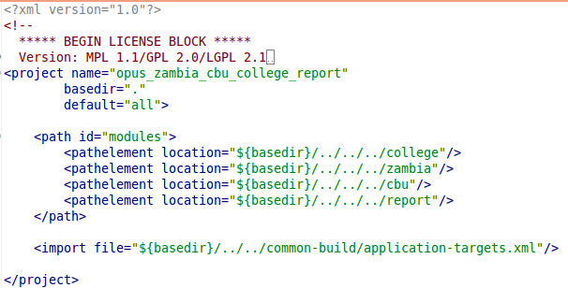
Building Opus with Ant scripts
Combination of modules built by Ant
Opus project is the application container
  opus/build contains the complete application after running ant script
  opus/application contain ant scripts
Example:
opus/application/
zambia_cbu_college_report

Slide 8
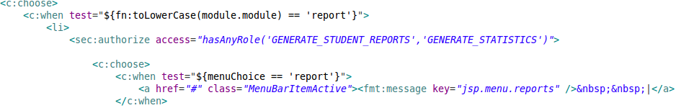
Integrating modules with the kernel
E.g. report
module in
menu.jsp
(kernel)
Add a menu for all module related functionality
Slight drawback: kernel has to know the existence of the report module (interdependency)

Slide 9
(3) Overriding particular (default) behavior
To alter specific (kernel) behavior, but do not want to replace an entire module
(for example: fast student input as an alternative to detailed student input)
Kernel needs to define an extension point
Module needs to implement an extension for the extension point
Same concept as in Eclipse
Compare extension point with interface

Slide 10
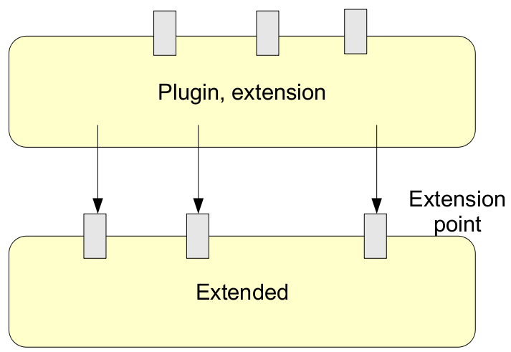
Extensions in Eclipse
(and in Opus)
E.g.
'fastInputExtension'
in the ucm
module
E.g. ext. point
'AddStudentScreen'
in the kernel
Details and example: ExtensionPointConcept.doc

Slide 11
Conclusion
Improvements can be made for local needs and for general needs
In order to keep update compatibility:
  follow one of the 3 approaches
    general improvements, module, or extensions
  commit changes to source code repository
    uncommitted local changes will create confusion
    may use local repository for own modules

